Slide 1
CAPSTONE PROJECT
RECIPE PREPARATION AGENT
Presented By: Archisman Chakraborty
Student name: Archisman Chakraborty
College Name & Department: University of Engineering and Management, Kolkata & Computer Science Engineering

Slide 2
OUTLINE
Problem Statement
Technology used
Wow factor
End users
Result
Conclusion
Git-hub Link
Future scope
IBM Certifications

Slide 3
PROBLEM STATEMENT
The core issue this project tackles is helping people figure out what to cook with the ingredients they already have on hand. This is a common problem for home cooks, students, and working professionals who want to save time and cut down on kitchen waste. The solution is to create an AI-powered agent that can generate tasty recipe ideas based on a user's available ingredients.
Proposed Solution:
The solution is an AI agent that uses the ingredients you give it to create recipes. It's built using IBM cloud services like Watsonx AI Studio and Watsonx AI runtime, and it leverages Natural Language Processing (NLP) and Retrieval Augmented Generation (RAG). The agent is powered by the IBM Granite foundation model. The project's code is available on GitHub.

Slide 4
TECHNOLOGY USED
IBM cloud lite services
Natural Language Processing (NLP) Retrieval Augmented Generation (RAG) IBM Granite model

Slide 5
IBM CLOUD SERVICES USED
IBM Cloud Watsonx AI Studio
IBM Cloud Watsonx AI runtime
IBM Cloud Agent Lab
IBM Granite foundation model

Slide 6
WOW FACTORS
This AI agent will significantly reduce meal planning stress, help users make the best use of available groceries, promote healthier eating habits, and reduce food wastage by providing smart, personalized cooking recommendations.
Unique Features:
It generates recipes instantly from your ingredients.
It provides easy-to-follow, step-by-step instructions.
It can even suggest smart substitutions for ingredients you might not have.
It offers cooking tips and nutritional highlights to make your meal even better.

Slide 7
END USERS
Home cooks and families
Students living away from home
Working Professionals
Anyone wanting to save time and reduce kitchen waste

Slide 8
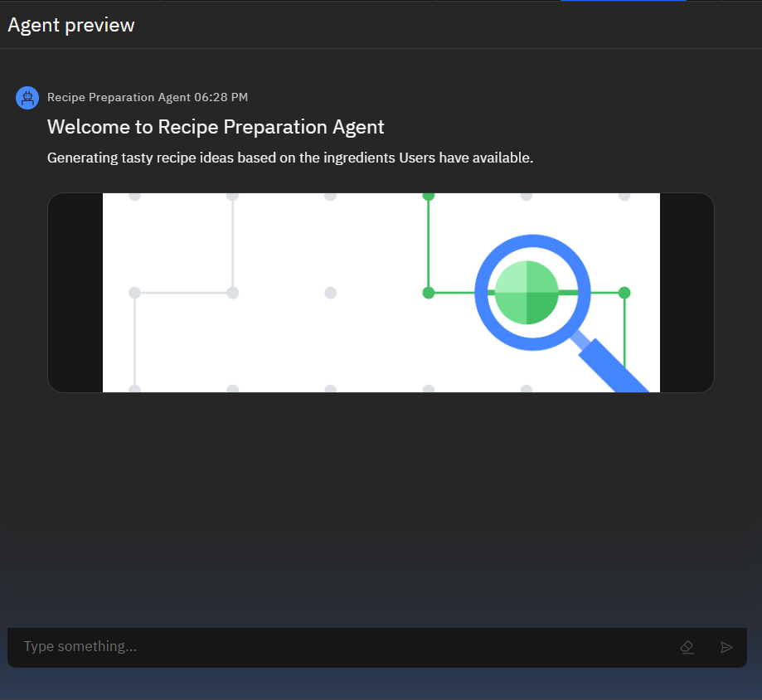
RESULTS

Slide 9
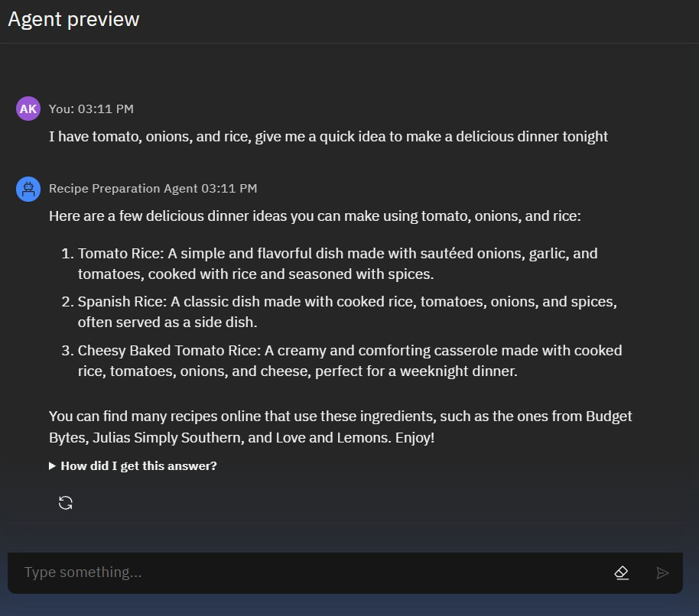
RESULTS
AC

Slide 10
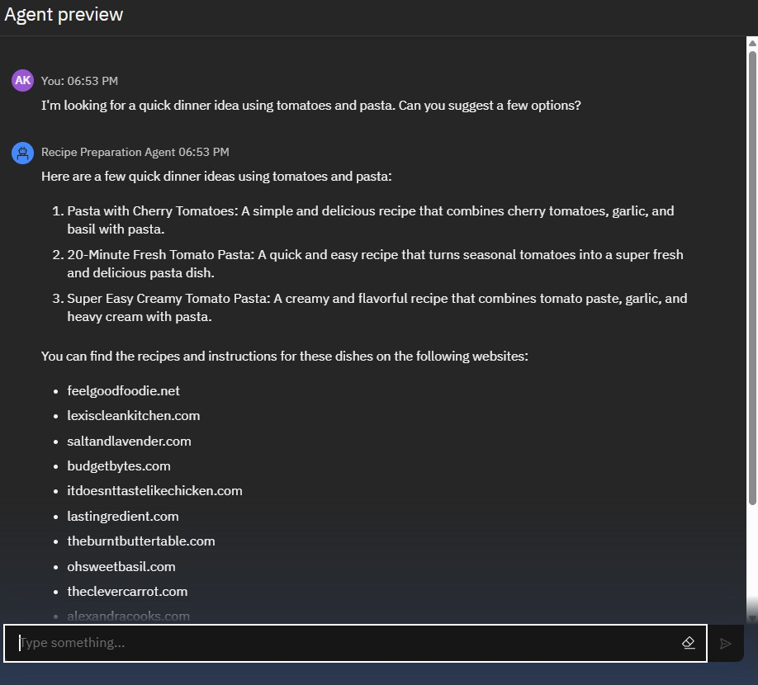

RESULTS
AC

Slide 11
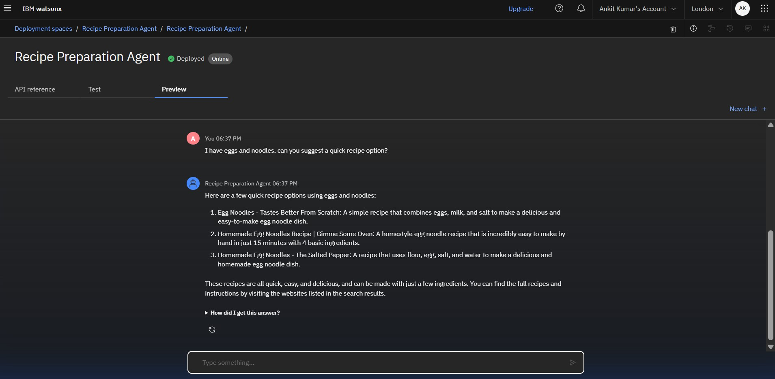
RESULTS
Deployed AI Agent
AC

Slide 12
CONCLUSION
The project successfully created a functional AI agent that solves the problem of generating recipes from a user's available ingredients. It uses advanced technologies like IBM's Granite LLM and RAG to provide practical and helpful recipe ideas, as shown in the examples with ingredients like "tomato, onions, and rice" or "eggs and noodles". The agent is a great tool for a variety of users and effectively tackles food waste and time constraints in the kitchen.

Slide 13
FUTURE SCOPE
Multi-language support for regional users (Hindi, Bengali, etc.)
Image-to-recipe generation using food photos
Grocery list generator from selected recipes
Advanced nutrition tracking via barcode/grocery input
Voice assistant integration for hands-free cooking

Slide 14
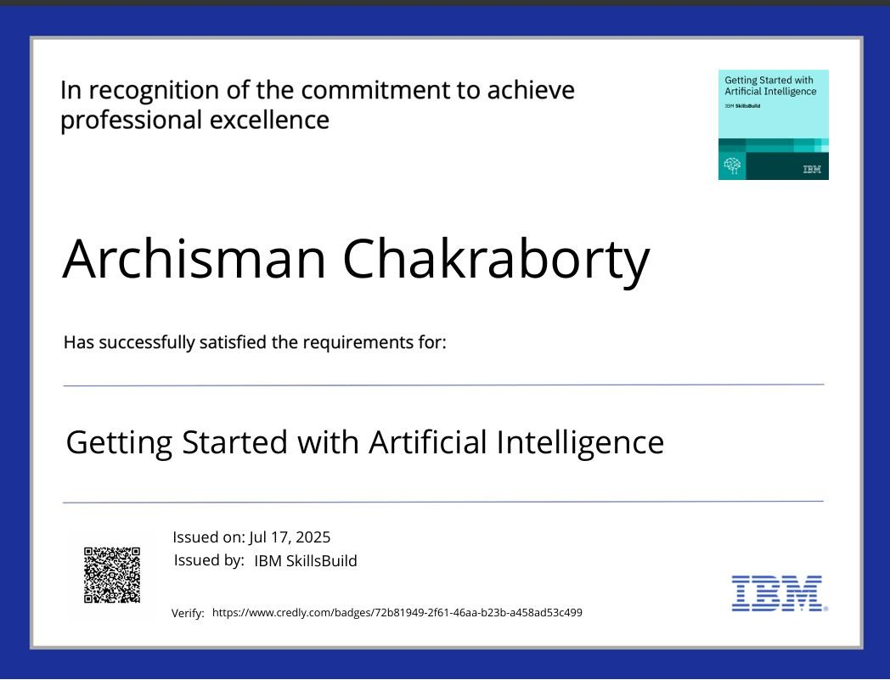
IBM CERTIFICATIONS
Screenshot/ credly certificate( getting started with AI)

Slide 15
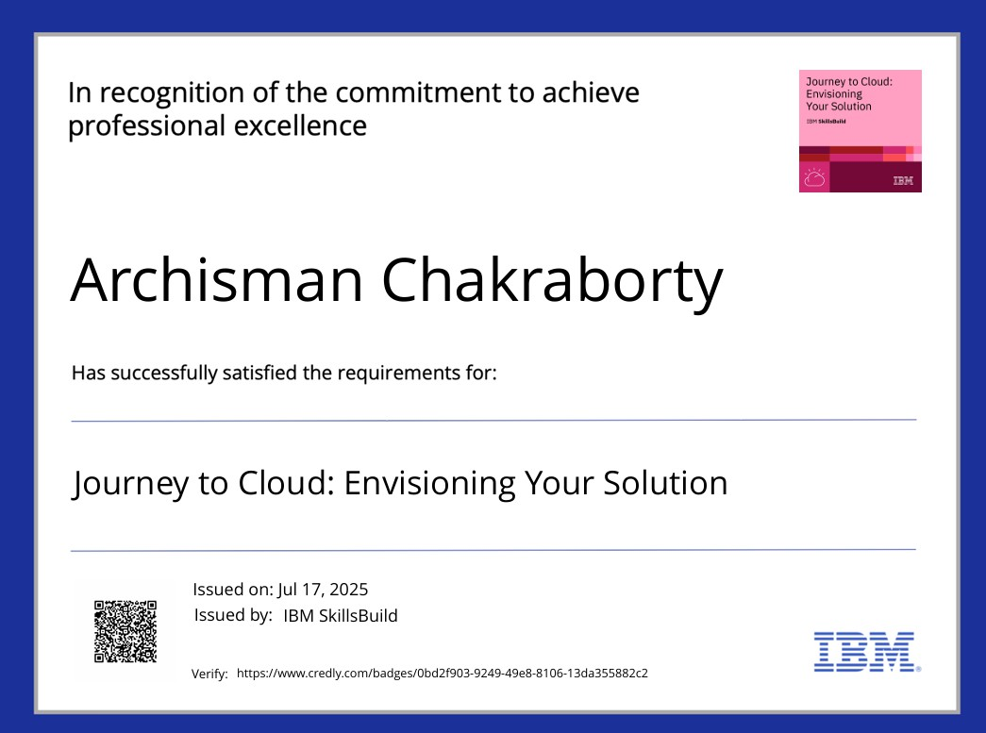
IBM CERTIFICATIONS
Screenshot/ credly certificate( Journey to Cloud)

Slide 16
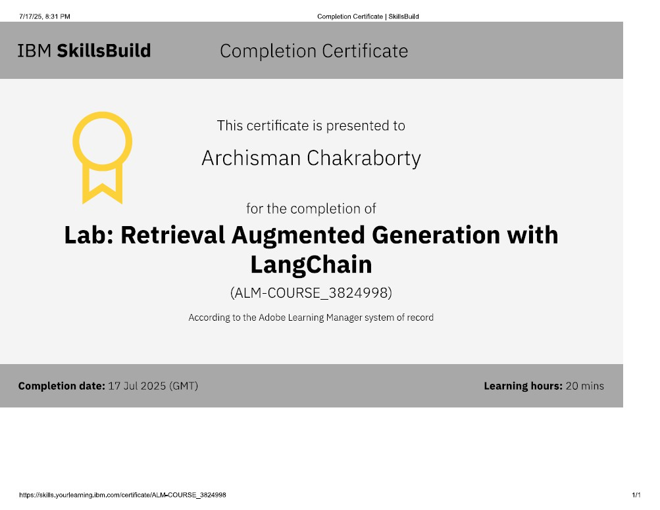
IBM CERTIFICATIONS
Attach your RAG LAB certificate here

Slide 17
GitHub Link: https://github.com/archisman44/IBM-CLOUD-EDUNET

Slide 18
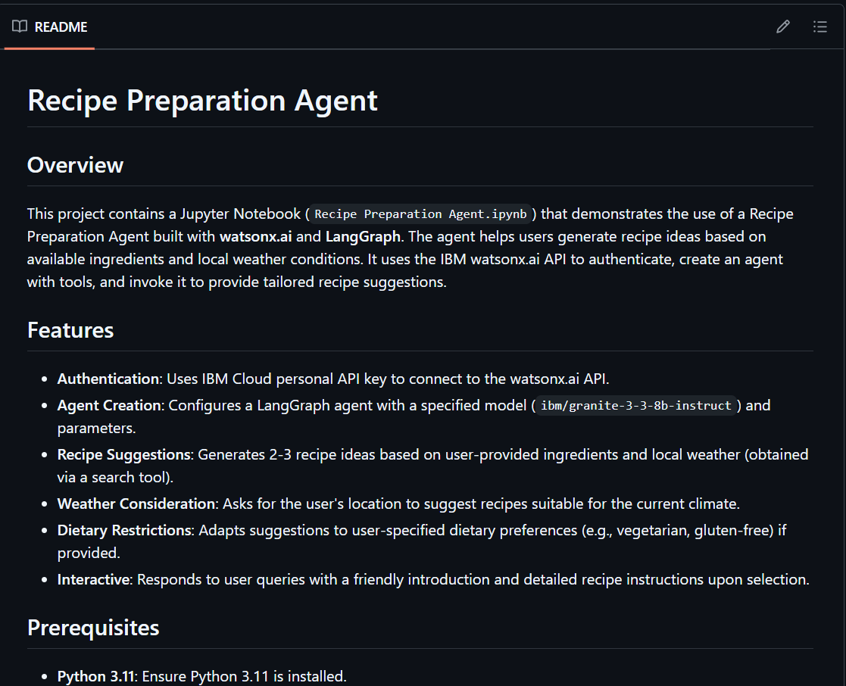
GITHUB LINK
Make sure that there should be readme file
- https://github.com/archisman44/IBM-CLOUD-EDUNET

Slide 19
THANK YOU

